Slide 1
ECE 551 Digital Design And Synthesis
Spring ‘19
Synthesis Flow
Synthesis Optimizations

Slide 2
Administrative Matters
HW5 Due Fri Apr 19th
Have you read the project spec yet? … it is posted at bottom of Canvas page

Slide 3
Internal Synthesizer Flow
HDL Description
Structural
Representation
Parsing and
Syntax & Semantic
Error Checking
Architectural
Optimization
Technology
Library
Synthesizer
Policy Checking
Multi-Level Logic
Optimization
Technology
Mapping
Translation
(Elaboration)
Technology-Based
Implementation
(netlist)

Slide 4
Initial Steps (Analyze Verilog File)
Parsing for Syntax and Semantics Checking
Gives error messages and warnings to user
User may modify the HDL description in response
Synthesizer Policy Checking
Check for adherence to allowable language constructs
Check for usage recommendations
This is where you find out you can’t use certain Verilog constructs
This is synthesizer-dependent
Example: Design Vision allows indexed part-select (guess[i*2 : 2]), but the Xilinx tool does not
Certain things common to MOST synthesizers

Slide 5
Translation (Elaboration)
Unrolls loops, substitutes macros & parameters, computes constant functions, evaluates generate conditionals
Builds a structural representation of the design
Like a netlist, but includes larger components
Not just gate-level, may include adders, etc.
Gives additional errors or warnings to the user
Issues in initial transformation to hardware.
Affects quality achieved by optimization steps
Structural representation depends on HDL quality
Poor HDL can prevent optimization

Slide 6
Importance of Translation
It is important for the tool to recognize the sort of logic structures you are trying to describe.
If it sees a 32-bit full adder, the tool has built-in solutions for optimizing adders
Ripple-carry, carry-save, carry look-ahead, etc.
If it just sees a Boolean function with 65 inputs, it has to work a lot harder to achieve the same results
Do you think it can invent a CLA on the fly?

Slide 7
Optimization in Synthesis
None of these are guaranteed!
Most synthesizers will make at least some attempt
Detect and eliminate redundant logic
Detect combinational feedback loops
Exploit don't-care conditions
Try to detect unused states (logic states you can’t get to)
Synthesize optimal, multilevel realizations subject to:
constraints on area and/or speed
available technology (library)

Slide 8
Optimization Process
Optimization modifies the initial netlist resulting from elaboration.
Architecture choices made first (CLA,RCA,…)
Boolean logic level optimization next
Maps to cells from the technology library
Attempts to meet all specified constraints
The process is divided into major phases
All or some selection of the major phases may be performed during optimization
Phase selection can be controlled by the user

Slide 9
Optimization Phases
Architectural optimization
High-level optimizations that occur before the design is mapped to the logic-level
Based on constraints and high-level coding style
Level of parallelism?
Building block choices like adder architecture (DW components)
After optimization circuit function is represented by a generic, technology-independent netlist (GTECH)

Slide 10
Architectural Optimization
In Synopsys, types include:
Sharing common mathematical subexpressions
Sharing resources
Selecting DesignWare implementations
Reordering operators
Identifying arithmetic expressions for datapath synthesis

Slide 11
Architectural Optimization
Examples:
Replace an adder used as a counter with incrementor
Replace adder and separate subtractor with adder/subtractor if not used simultaneously
if (~sub) z = a + b; else z = a – b;
Performs selection of pre-designed components (Synopsys DesignWare)
adders, multipliers, shifters, comparators, muxes, etc.
Need good code for synthesizer to do this
Designer still knows more about the project

Slide 12
Logic/Gate-Level Optimization
Works on the generic netlist created by logic synthesis
Produces a technology-specific netlist.
In Synopsys, it consists of four stages:
Mapping
Delay optimization
Design rule fixing
Area optimization
This phase often runs in multiple iterations if constraints are not met on the first try

Slide 13
Logic/Gate-Level Optimization
Mapping
Generates a gate level implementation
Tries to meet timing and area goals
Delay optimization
Tries to fix delay violations from mapping phase.
Does not fix design rule violations or meet area constraints.
Design rule fixing
Tries to correct design rule violations
Inserting buffers or resizing existing cells
If necessary, violates optimization constraints
Area optimization
Tries to meet area constraints, which have lowest priority

Slide 14
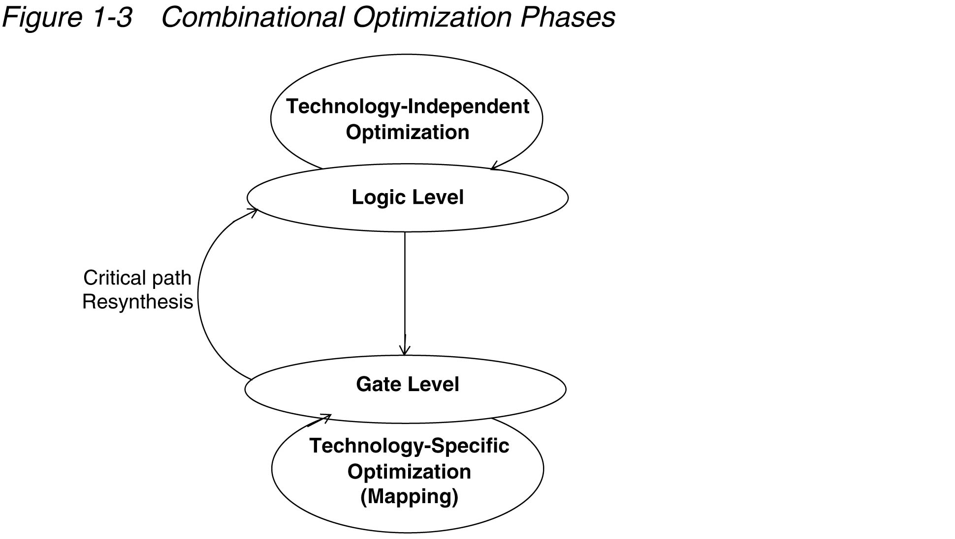
Combinational Optimization
Boolean equation manipulation
Boolean reduction
Factoring
Sharing common terms
Mapping Optimizations
Gate mapping based on CF
Applying De-Morgans
Sizing Gates & Buffering

Slide 15
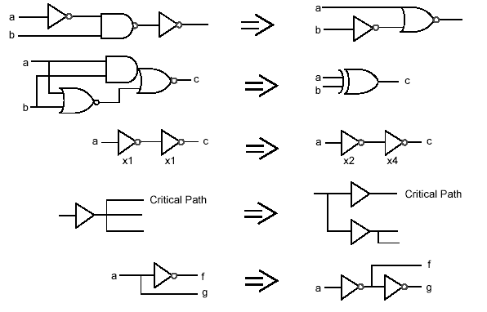
Gate-Level Optimization

Slide 16
Logic-Level Optimizations
Verilog
Technology
Description
Libraries
TRANSLATION
OPTIMIZATION
MAPPING
ENGINE
ENGINE
ENGINE
Optimized
Two-level
Technology
Multi-level Logic
Logic Functions
Implementation
Functions

Slide 17
Logic Optimizations
Area
Number of gates fewer == smaller
Fan in of gates (# inputs) fewer == smaller
Drive Strength (transistor width) narrower == smaller
Delay
Number of logic levels fewer == faster (usually)
Fan in of gates (# inputs) fewer == faster
Gate Effort ➔ Summation of Fan in of gates needed to implement function
Note that examples that follow ignore NOT gates for gate count / levels of circuits

Slide 18
Logic Optimizations
Decomposition
Extraction
Factoring
Substitution
Elimination
You don’t have to remember the names of these
But understand the concept and the motivation

Slide 19
Decomposition
Find common expressions
Reduce redundancy
Reduce area (number/size of gates)
May increase delay
More levels of logic

Slide 20
Decomposition Example
F = abc + abd + a’c’d’ + b’c’d’ ~7 gates, ~3 levels
F = ab(c + d) + c’d’(a’ + b’)
F = ab(c + d) + (c + d)’(ab)’
X = ab 1 gate, 1 level
Y = c + d 1 gate, 1 level
F = XY + X’Y’ 3 gates, 3 levels (or what?)
Gate Effort = 4*(3-input AND) + 4-input OR = 16 effort
Gate Effort = 2-input AND + 2-input OR + 2*(2-input AND) + 2-input OR = 10 effort

Slide 21
Extraction
Find common sub-expressions in functions
Like decomposition, but across more than one function
Reduce redundancy
Reduce area (number/size of gates)
May increase delay if more logic levels introduced

Slide 22
Extraction Example
F = (a + b)cd + e 3 gates, 3 levels
G = (a + b) e’ 2 gates, 2 levels
H = cde 1 gate, 1 level
Define common terms: X = a + b, Y = cd 1 gate, 1 level (each)
F = XY + e 3 gates, 3 levels
G = Xe’ 2 gate, 2 levels
H = Ye 2 gate, 2 levels
Before:
(3) 2-input ORs, (2) 3-input ANDs, (1) 2-input AND
Gate Effort = 6 + 6 + 2 = 14
After
(2) 2-input ORs, (4) 2-input ANDs
Gate Effort = 4 + 8 = 12

Slide 23
Factoring
Traditional two-level logic is sum-of-products
Sometimes better expressed by product-of-sums
Fewer literals => less area
May increase delay if logic equation not completely factored (becomes multi-level)

Slide 24
Factoring Example
Definitely good:
F = ac + ad + bc + bd Gate Effort = 8 + 4
F = (a + b)(c + d) Gate Effort = 4 + 2
Maybe good:
F = ac + ad + e Gate Effort = 7
F = a(c + d) + e Gate Effort = 6
Factoring may improve area...
But will likely increase delay (tradeoff)

Slide 25
Substitution
Similar to Extraction (in fact a sub-case of extraction)
When one function is subfunction of another
Reduce area
Fewer gates
Can increase delay if more logic levels

Slide 26
Substitution Example
G = a + b 1 gate, 1 level
F = a + b + c 1 gate, 1 level
F = G + c 2 gate, 2 levels
Before:
(1) 2-input OR, (1) 3-input OR => Gate Effort = 5
After
(2) 2-input ORs (but increased levels) => Gate Effort = 4

Slide 27
Elimination (Flattening)
Opposite of previous optimizations
Goal is to reduce delay
Make signals travel though as few logic levels as possible
But will likely increase area
Gate replication / redundant logic

Slide 28
Elimination Example
G = c + d 1 gate, 1 level
F = Ga + G' b 3 gates, 3 levels
G = c + d 1 gate, 1 level
F = ac + ad + bc’d’ 4 gates, 2 levels
Before:
(2) 2-input ORs, (2) 2-input ANDs
After:
(1) 2-input OR, (1) 3-input OR, (2) 2-input ANDs, (1) 3-input AND (but fewer levels)

Slide 29
compile_ultra Optimizations
High effort, maximum optimization
Automatic hierarchical ungrouping
Ungroups small modules before mapping
Ungroups critical path based on delay
Automatic datapath extraction
E.g. carry-save adders
Boundary optimization
Propagates logic across hierarchical boundaries (constants, NC inputs/outputs, NOT)
Sequential inversion
Sequential elements can have their outputs inverted

Slide 30


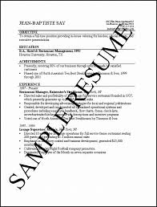
How to Ensure a Job Offer Once You Have the on-site Interview

Slide 31
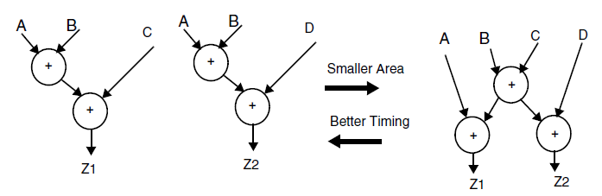
Sharing and Unsharing
Expression sharing may be overridden later due to timing
Z1 <= A + B + C
Z2 <= A + B + D
Arrival time is A < B < D < C
C
A

Slide 32
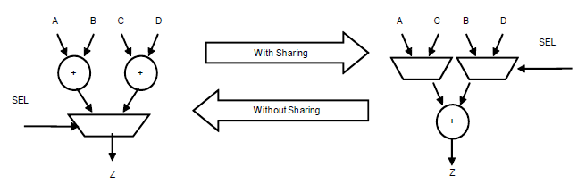
Sharing and Unsharing
Mutually exclusive operations can share resources
if(SEL) Z = A + B
else Z = C + D

Slide 33
Sequential Inversion
set compile_seqmap_enable_output_inversion true
Allows the mapping of sequential elements in the design to library cells whose outputs are inverted.
This can reduce area and or speed
Not applicable for compile_ultra, because compile_ultra already does this.

Slide 34
Register Retiming
At the HDL level, determining the optimal placement of registers is difficult and tedious at best, or just plain impossible at worst
The register retiming tool moves registers through the synthesized combinational logic network to improve timing and/or area
Equalize delay (i.e. reduce critical path delay by increasing delay in other paths)
Reduce the number of flip-flops if timing criteria are met
Usually propagate registers forward
Can also automatically pipeline combinational logic modules

Slide 35
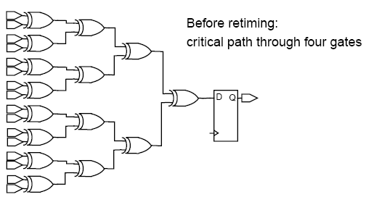
Register Retiming Example [1]
optimize_registers is the command in Design Compiler

Slide 36
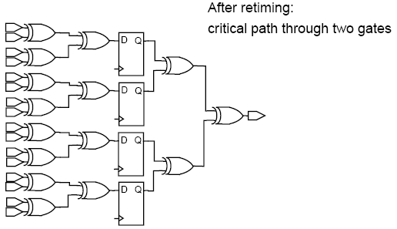
Register Retiming Example [2]
Personally: I would never use this. I have an inherent mis-trust of CAD tools. I would never let it move any of my flops, and certainly never trust it to rearrange my pipelined processor.

